Slide 1
Times tables
Topic: Measurement
EQ: How do I convert units and find perimeter

Slide 2
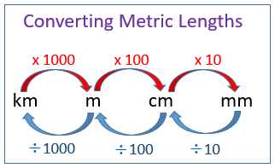
24
7
30
Topic: Revision of Perimeter and Area
EQ: How do convert units and find perimeter?
How do I convert units of length and capacity?
6000m = km
14500m = km
0.9km = m
200cm = m
340cm = m
1.2m = cm
0.8m = cm
22cm = mm
5cm = mm
70mm = cm
105mm = cm
2000mL = L
1570mL = L
0.95L = ml
1000 ml = 1L
1000L = 1 kL

Slide 3
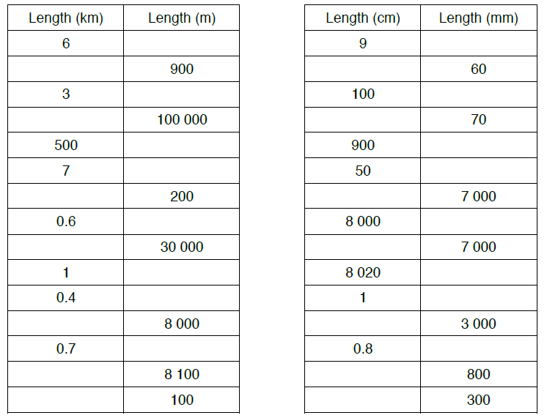
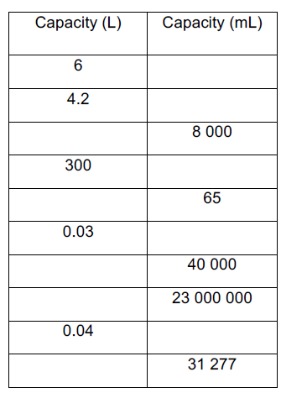
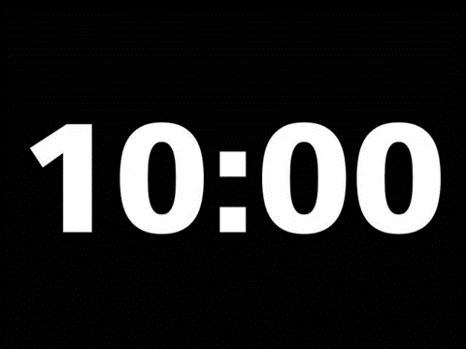

Slide 4
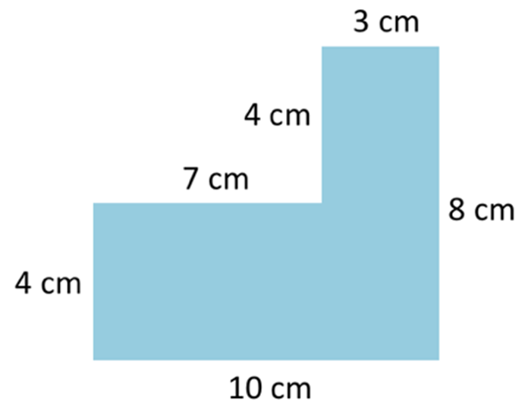
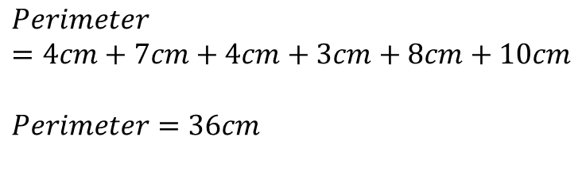
24
7
30
Topic: Revision of Perimeter and Area
EQ: How do I convert units and find perimeter?
What is Perimeter?
Perimeter is the length around the outside edge of the shape. It is a linear (one dimensional) measurement so the units are always mm, cm, m, km etc.
To determine the perimeter:
Add up the lengths of each side
Use an appropriate formula
Use your knowledge of shapes to help**
**Especially for missing dimensions
$$Perimeter=4cm+7cm+4cm+3cm+8cm+10cm$$
$$Perimeter=36cm$$

Slide 5
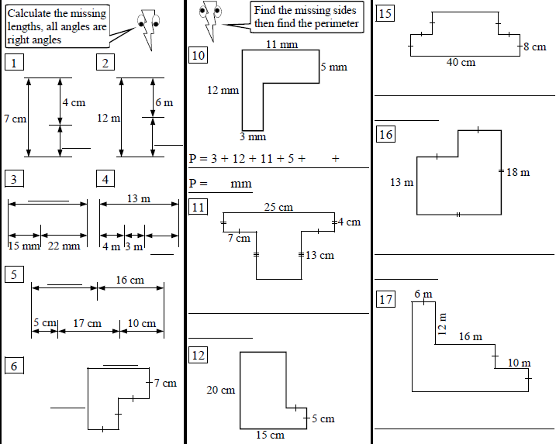

Slide 6
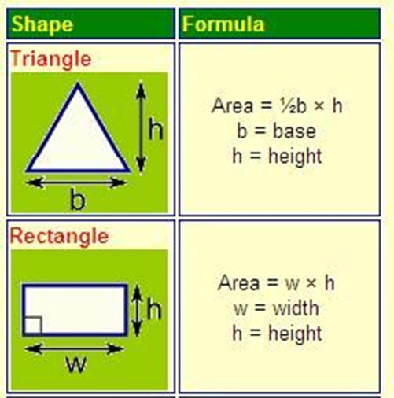
24
7
30
Topic: Revision of Perimeter and Area
EQ: How do I find the area of rectangles, squares and triangles?
What is area?
Area is the amount of flat space a 2-dimensional shape takes up.
units, mm², cm², m², km² etc.
Determine area using formula
Make sure you know triangles and rectangles (use for squares as well)
Hint to help remember – a triangle is just half the area of a rectangle

Slide 7
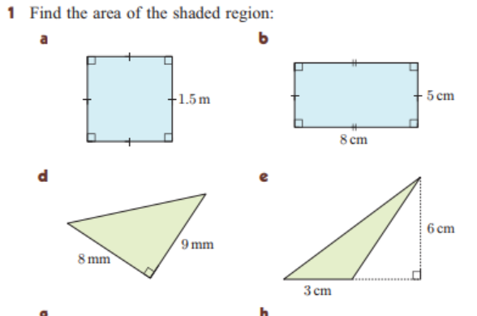
If a square has an area of 25cm squared, what is the length of its sides?
If a rectangle has an area of 48cm squared and one side with length 6cm, what is the length of the other side?
If a triangle has an area of 40cm squared and a height of 5cm, what is the base length of the triangle?

